Slide 1

Super Store Analysis
[Deeraj Natarajan ]

Slide 2

PROBLEM STATEMENT
The Superstore Analysis dataset aims to evaluate sales performance, customer behavior, and inventory management across various product categories and regions. By analyzing this data, we seek to identify trends, optimize operations, and enhance decision-making processes to improve profitability and customer satisfaction in the retail environment.
By leveraging data-driven insights, the goal is to develop strategic recommendations for improving operational efficiency and market competitiveness. Key questions include: What are the top-performing products? How do regional sales vary? What customer segments contribute most to profits? Addressing these will guide strategic decision-making and business growth.

Slide 3
Project Description The dataset represents transactional data from a Super Store, including details such as shipping modes, customer segments, geographic locations (city, state, and postal code), sales performance, product categories, discounts, and profitability. The analysis focuses on understanding sales trends, profit margins, and customer behavior across different regions, categories, and shipping methods. By leveraging this data, businesses can optimize supply chain decisions, improve marketing strategies, and increase operational efficiency. Additionally, insights about customer segments help in targeted promotions and product positioning to drive more sales and profitability.

Slide 4

WHO ARE THE END USERS?
The primary end users of this analysis include business managers, supply chain analysts, and marketing teams within the retail sector. Additionally, C-suite executives and data-driven decision-makers will benefit from the insights to improve operational efficiency, increase profitability, and enhance customer satisfaction. Strategic planners in charge of regional or product-specific performance can also utilize this data to make informed decisions regarding inventory management, customer segmentation, and marketing campaigns.

Slide 5

Technology Used
Data Analysis Tools:
The project employs Python for data manipulation and analysis, utilizing libraries like pandas for data exploration and aggregation.
Visualization: Visualization tools such as matplotlib and seaborn can be used to present trends, sales performance, and customer segmentation in a clear and insightful manner.

Slide 6
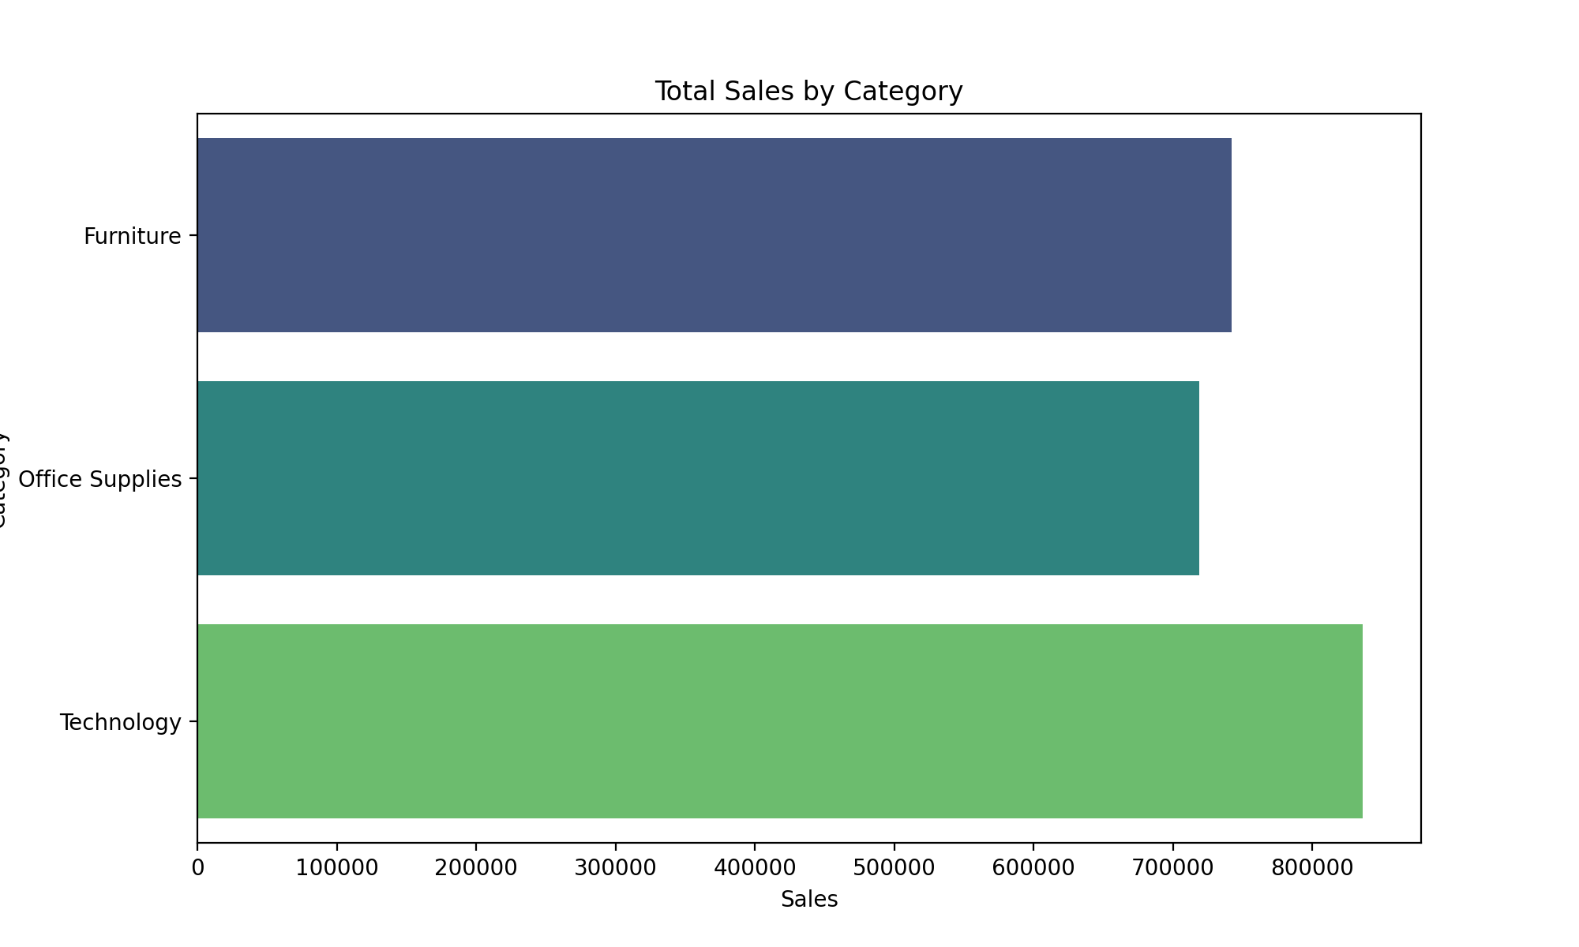
RESULTS
[Add screen shots of your code ]
Demo Link

Slide 7
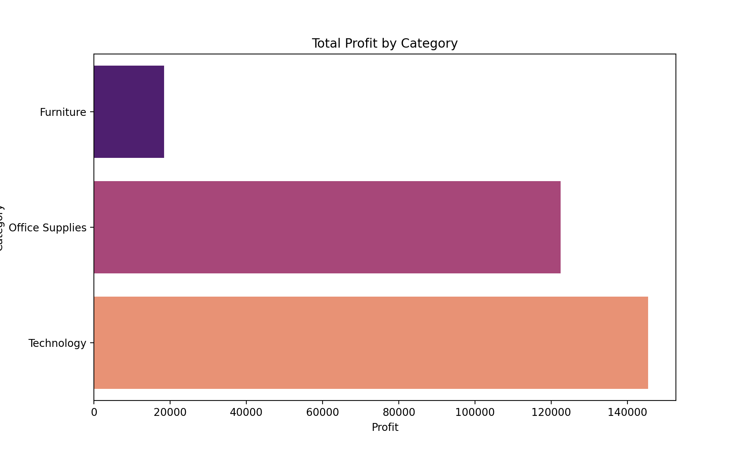
RESULTS
[Add screen shots of your code ]
Demo Link

Slide 8
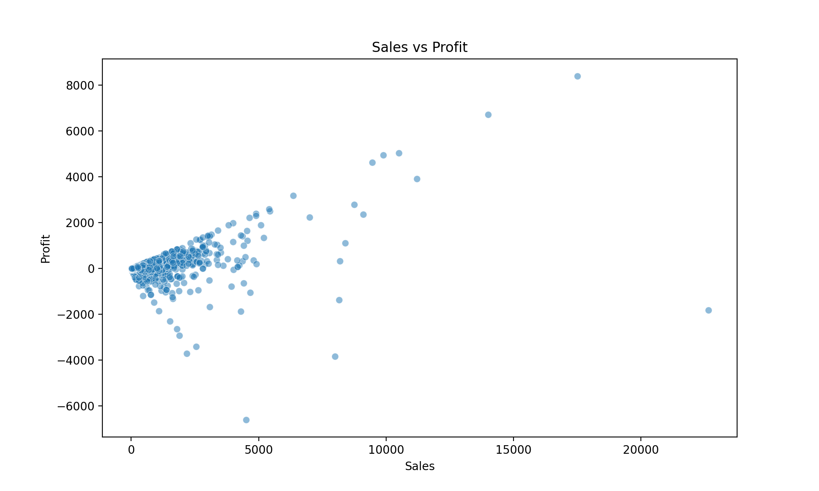
RESULTS
[Add screen shots of your code ]
Demo Link

Slide 9
Thank you
This project provides valuable insights into sales and profitability patterns within the retail store.
By identifying high-value customers, profitable product categories, and cost-effective shipping modes, the company can strategically align its operations and marketing efforts.
Implementing findings from this analysis will help the store increase profit margins, streamline supply chain processes, and cater more effectively to customer demands, ultimately fostering sustainable growth.
.
.

